Slide 1


M.Tech Program
Advanced Industry Integrated Programs
Jointly offered by University and LTIMindTree
Review III
Project Title
ClusterMind: Multi-Agent GPU Workload Assurance and Recovery Platform
Team Member
Dhayanidhi R S
Knowledge partner | Implementation partner
Notes:
ClusterMind detects GPU degradation, explains its workload impact, identifies the probable cause, and recommends a safe recovery action.

Slide 2
ClusterMind: Multi-Agent GPU Workload Assurance and Recovery Platform
Introduction
Background
  Modern AI training and inference depend on costly, long-running GPU clusters where thermal, memory, power, hardware and interconnect issues can reduce throughput, interrupt workloads and waste compute capacity.
  Existing monitoring platforms expose these failures as technical metrics, but understanding the workload impact, probable cause, and correct recovery action still requires expert manual analysis.
Proposed System
  ClusterMind is an end-to-end GPU assurance platform that collects telemetry, detects anomalous behavior, evaluates workload impact, and coordinates four specialized agents to diagnose the probable cause and recommend recovery.
Notes:
ClusterMind converts raw GPU telemetry into an understandable incident explanation and a controlled recovery recommendation.

Slide 3
ClusterMind: Multi-Agent GPU Workload Assurance and Recovery Platform
Objectives
Detect abnormal GPU behavior from correlated telemetry.
Measure the impact on training and inference workloads.
Identify probable root causes using evidence and runbooks.
Generate safe, checkpoint-aware recovery recommendations.
Keep infrastructure-changing actions behind human approval.
Provide end-to-end monitoring, tracing, and operator visibility.
Notes:
The objective is not only anomaly detection. The system must explain what happened, why it matters, and what should be done safely.

Slide 4
ClusterMind: Multi-Agent GPU Workload Assurance and Recovery Platform
ClusterMind Core Modules
GPU Telemetry and Simulation
Generates correlated GPU, node, workload, and incident telemetry for a 40-GPU synthetic cluster.
Anomaly Detection
Uses Isolation Forest and deterministic hardware rules to identify candidate GPU anomalies.
Multi-Agent Intelligence
Coordinates Telemetry, Workload Impact, Root Cause, and Recovery Agents through LangGraph.
Human Approval and Recovery
Presents evidence-backed recovery plans before any migration, restart, or quarantine action.
Operations and Observability
Combines Streamlit, Grafana, InfluxDB, Prometheus, OpenTelemetry, Jaeger, Redis, Celery, and ntfy.
Notes:
Each module has one clear responsibility, allowing the platform to remain modular, testable, and replaceable.

Slide 5
ClusterMind: Multi-Agent GPU Workload Assurance and Recovery Platform
Problem Statement
GPU monitoring tools expose technical metrics but lack operational explanation.
High utilization may represent either productive work or harmful degradation.
A hardware anomaly does not automatically reveal workload impact or root cause.
Manual diagnosis increases incident response time and requires specialist knowledge.
Fully autonomous recovery is unsafe for costly training and inference workloads. Therefore a unified, explainable, human-controlled assurance platform is required.
Notes:
The key problem is the gap between detecting an unusual metric and making a safe operational decision. The core problem is not the absence of monitoring; it is the gap between an alert and a trustworthy operational decision.

Slide 6
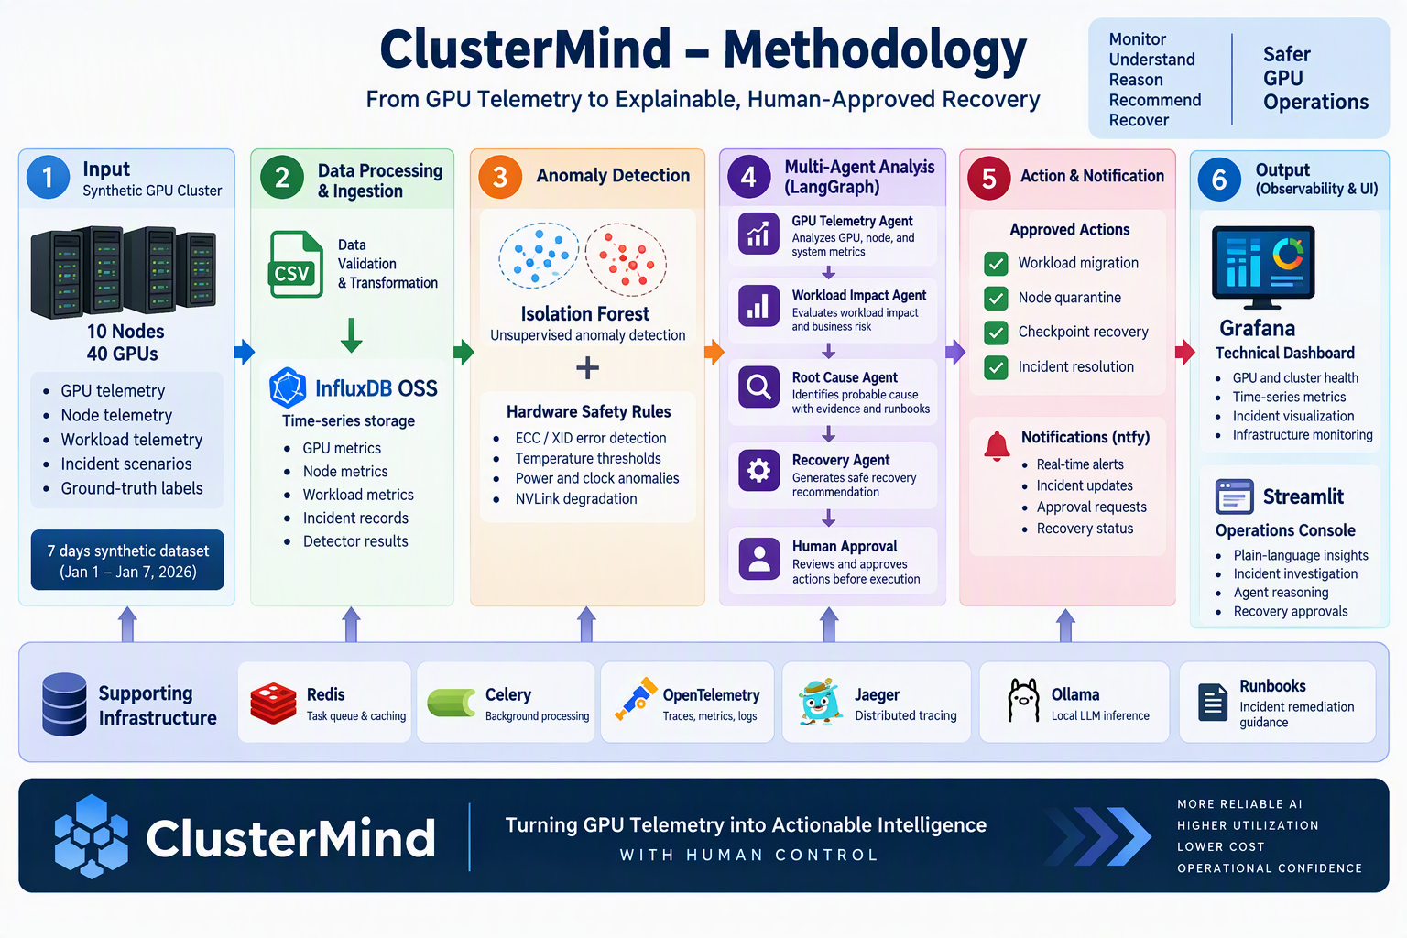
ClusterMind: Multi-Agent GPU Workload Assurance and Recovery Platform
Methodology
Notes:
The methodology separates deterministic detection, agent reasoning, and human authorization rather than allowing one model to control the entire process.

Slide 7
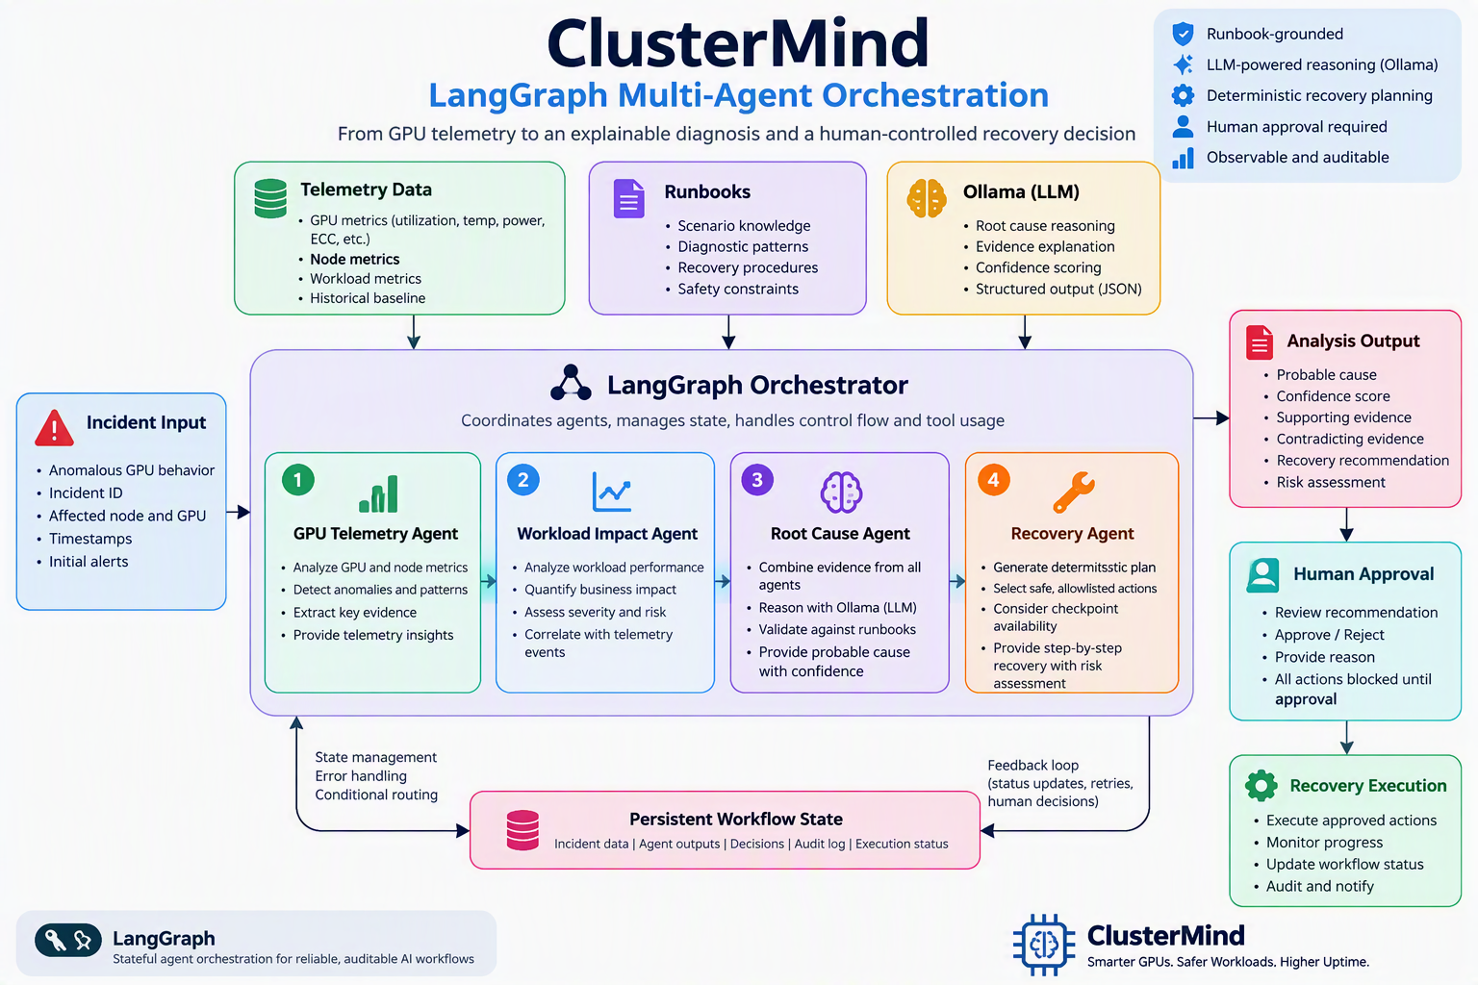
ClusterMind: Multi-Agent GPU Workload Assurance and Recovery Platform
Notes:
The methodology separates deterministic detection, agent reasoning, and human authorization rather than allowing one model to control the entire process.

Slide 8
ClusterMind: Multi-Agent GPU Workload Assurance and Recovery Platform
Approach & Tools
Data Layer: Synthetic GPU cluster, workload telemetry, incident labels, InfluxDB OSS
Detection Layer: StandardScaler, Isolation Forest, ECC/XID/temperature safety overrides
Agent Layer: LangGraph with Telemetry, Workload Impact, Root Cause, Recovery Agents
Reasoning Layer: Local Ollama model with structured prompts, runbooks, and evidence
Application Layer: FastAPI, Streamlit operations console, Grafana technical dashboards
Execution Layer: Redis, Celery, checkpoint-aware recovery, human approval, ntfy
Observability Layer: Prometheus, OpenTelemetry, Jaeger, structured application metrics
Notes:
The entire implementation is open-source and locally deployable through an isolated Docker Compose stack.

Slide 9
ClusterMind: Multi-Agent GPU Workload Assurance and Recovery Platform
Key Findings
High GPU utilization is not automatically a failure; workload progress must also be evaluated.
Unsupervised anomaly detection is effective for candidate screening, but insufficient for final incident decisions.
Explicit ECC, XID, and temperature rules are essential for safety-critical hardware events. Correlating GPU and workload telemetry reduces misleading infrastructure-only conclusions.
Specialized agents produce clearer and more auditable decisions than a single general-purpose agent.
Human approval is necessary before workload migration, restart, checkpoint recovery, or node quarantine.
GPU Anomaly + Workload Impact + Operational Context = Actionable Incident
Notes:
The main finding: telemetry becomes actionable only when hardware state, workload impact, and recovery risk are evaluated together.

Slide 10
ClusterMind: Multi-Agent GPU Workload Assurance and Recovery Platform
Results
Dataset and Validation:
10 simulated nodes with 40 GPUs, 7 days of correlated telemetry at 5-minute intervals
80,640 GPU telemetry records, 20,160 node records, and 20,160 workload records
35 labelled incidents across 6 GPU failure scenarios
63 unit tests passed across generation, scenarios, and export layers
Isolation Forest Baseline:
Precision: 11.32% Recall: 38.26% F1 Score: 17.47% False-Positive Rate: 3.64%
End-to-End Outcome:
ClusterMind was completed as an end-to-end, containerized GPU assurance platform covering telemetry generation, time-series ingestion, anomaly detection, multi-agent diagnosis, workload-impact analysis, recovery planning, and human approval.
Notes:
The main result is a verified end-to-end incident path from telemetry ingestion to explainable, human-approved recovery. Isolation Forest is used as a candidate-anomaly detector; final decisions are produced through workload correlation and multi-agent reasoning.

Slide 11
ClusterMind: Multi-Agent GPU Workload Assurance and Recovery Platform
Conclusion
ClusterMind bridges monitoring, diagnosis, and controlled recovery.
Multi-agent reasoning converts technical telemetry into operational decisions.
Workload correlation prevents high utilization from being treated as automatic failure.
Human approval keeps recovery actions safe and auditable.
The hybrid Streamlit and Grafana interface supports both users and engineers.
The architecture is modular, observable, open-source, and deployment-ready.
Notes:
ClusterMind transforms GPU monitoring from “What changed?” into “What happened, why it matters, and what should we safely do next?”
The system’s value is not another dashboard. Its value is converting telemetry into an explainable and controlled operational response.

Slide 12
ClusterMind: Multi-Agent GPU Workload Assurance and Recovery Platform
Acknowledgement
I sincerely thank:
  My manager and project mentors for their guidance and technical feedback.
  My organization and internship team for the opportunity and resources.
  The open-source communities behind the technologies used in ClusterMind.
  Everyone who supported the reviews, testing, and refinement of this project.

Slide 13
ClusterMind: Multi-Agent GPU Workload Assurance and Recovery Platform
References
[1] H. Liu, Z. Li, C. Tan, R. Yang, G. Cao, Z. Liu, and C. Guo, “Predicting GPU Failures With High Precision Under Deep Learning Workloads,” in Proc. 16th ACM Int. Syst. Storage Conf. (SYSTOR), Haifa, Israel, 2023, pp. 124–135, doi: 10.1145/3579370.3594777.
[2] Z. Yao, P. Hu, C. Miao, X. Jia, Z. Liang, Y. Xu, C. He, H. Lu, M. Chen, X. Li, Z. He, Y. Wang, X. Zou, and J. Jiang, “Holmes: Localizing Irregularities in LLM Training with Mega-Scale GPU Clusters,” in Proc. 22nd USENIX Symp. Networked Syst. Design Implement. (NSDI), Philadelphia, PA, USA, 2025.
[3] Q. Weng, W. Xiao, Y. Yu, W. Wang, C. Wang, J. He, Y. Li, L. Zhang, W. Lin, and Y. Ding, “MLaaS in the Wild: Workload Analysis and Scheduling in Large-Scale Heterogeneous GPU Clusters,” in Proc. 19th USENIX Symp. Networked Syst. Design Implement. (NSDI), Renton, WA, USA, 2022, pp. 945–960.
[4] T. Kim, S. Jeong, J. Lee, S. Lee, and M. Jeon, “Sibylla: To Retry or Not To Retry on Deep Learning Job Failure,” in Proc. USENIX Annu. Tech. Conf. (USENIX ATC), Carlsbad, CA, USA, 2022, pp. 263–270.
[5] Y. Chen et al., “Automatic Root Cause Analysis via Large Language Models for Cloud Incidents,” in Proc. 19th Eur. Conf. Comput. Syst. (EuroSys), Athens, Greece, 2024, pp. 674–688, doi: 10.1145/3627703.3629553.
[6] Z. Wang, Z. Liu, Y. Zhang, A. Zhong, J. Wang, F. Yin, L. Fan, L. Wu, and Q. Wen, “RCAgent: Cloud Root Cause Analysis by Autonomous Agents with Tool-Augmented Large Language Models,” in Proc. 33rd ACM Int. Conf. Inf. Knowl. Manage. (CIKM), Boise, ID, USA, 2024, pp. 4966–4974, doi: 10.1145/3627673.3680016.

Slide 14
ClusterMind: Multi-Agent GPU Workload Assurance and Recovery Platform
Reference
[7] D. Roy, X. Zhang, R. Bhave, C. Bansal, P. Las-Casas, R. Fonseca, and S. Rajmohan, “Exploring LLM-Based Agents for Root Cause Analysis,” in Companion Proc. 32nd ACM Int. Conf. Found. Softw. Eng. (FSE Companion), Porto de Galinhas, Brazil, 2024, doi: 10.1145/3663529.3663841.
[8] S. D. Zhang, X. Zhang, C. Bansal, P. Las-Casas, R. Fonseca, and S. Rajmohan, “LM-PACE: Confidence Estimation by Large Language Models for Effective Root Causing of Cloud Incidents,” in Companion Proc. 32nd ACM Int. Conf. Found. Softw. Eng. (FSE Companion), Porto de Galinhas, Brazil, 2024, pp. 388–398, doi: 10.1145/3663529.3663858.
[9] T. Guo, X. Chen, Y. Wang, R. Chang, S. Pei, N. V. Chawla, O. Wiest, and X. Zhang, “Large Language Model Based Multi-Agents: A Survey of Progress and Challenges,” in Proc. 33rd Int. Joint Conf. Artif. Intell. (IJCAI), Jeju, Republic of Korea, 2024, pp. 8048–8057, doi: 10.24963/ijcai.2024/890.
[10] A. Bento, J. Correia, R. Filipe, F. Araujo, and J. Cardoso, “Automated Analysis of Distributed Tracing: Challenges and Research Directions,” J. Grid Comput., vol. 19, no. 1, Art. no. 9, 2021, doi: 10.1007/s10723-021-09551-5.

